Slide 1
IoT Sensor Data Analysis
Vaibhav Purohit

Slide 2
Brief Recollection
IoT and Big Data Analytics are the two current happening technologies
Manufacturing Industries face obstacles regarding-
Data Accuracy
Timely Recordings
Hazard Risks
Use of data within its lifecycle
IoT and Big Data Integration provides a solution for insolvencies
Increased capabilities and efficiencies are also scratched upon

Slide 3
Agenda
Project Overview
Why?
Functionalities
System Architecture
Benefits
Challenges
Work Flow
UML Diagrams
Use Case Diagram
Sequence Diagram
Data Gathering and Analysis
Result Access
Class Diagram
Requirement Specification
Hardware Requirements
Database Design
Future Scope
Conclusion

Slide 4
Sensor Data Analysis- Project Overview
Industrial Actuators & Sensors gather data sets to the IoT Server.
IoT server interactions with the Big data File System providing data to be analysed.
MapReduce Engine runs analysis over the large sets of gathered data.
Deduced conclusions are transferred to the IoT Server.
These conclusions can be accessed via the mobile application for an Infographic representation.
Notes:
1. This is a smart phone, adroid based app….
2. The Wifi facility is provided by ESP while Arudnion is the microcontroller
3.
4.

Slide 5
WHY?
Adverse conditions in general Industrial premises lead to mishaps or tainted data gathering.
IoT removes the human intervention via smart devices transmitting their own data to the server.
Reduced Hazards
Accurate Data Gathering
Huge amounts of data overwhelm the industry.
Big data Analytics provides fast and efficient conclusions over data sets.
Access and Interpretation of data on time becomes a necessity.
Mobile Application provides remote access of infographic representation.

Slide 6
Functionalities
The basic appealing features provided by the project concept are-
Smart industrial surroundings
Human Intervention abated
High Accuracy
Reduced Mishaps
Timely and Reliable Recordings
Data Analysis
Fast Overviews
Pattern recognition hidden in data
Predictive Analysis
Mobile Application
Remote Access
Event Driven Action Initiation

Slide 7

System Architecture
Big Data Server
Placed Sensors
1
IoT Server
2
3
Mobile Device
Mobile Database
4

Slide 8
Benefits
Smart surroundings
Higher accuracy
Timely recordings
Reduced human intervention
Less risk to life
Reliability
Real time result access
Remote access to results
On time predictions
Event driven actions

Slide 9
Challenges
Initial investment
Significant amendments in current setup
Expert handling required

Slide 10
Work Flow
Entities
Smart and connected entities
Smart Sensors, actuators transmit data
Gateways
Data Object transmission via RESTful services.
Cloud Management
Data Center and storage
Remote Access
Gathering data at IoT Server
Complex analytics on large data sets via HDFS
Visualize data conclusions
Monetize insights
Unified Connection of Modules for Project Platform

Slide 11
Development Methodology
Planning and Design
Microsoft Project Planner
Development
Arduino IDE or BlueJ IDE
Android Studio
RESTful Services (GET & POST)

Slide 12
UML Diagrams
Unified Modelling Language
A pictorial language used to make software blueprints
A language to visualize, specify, construct, and document software systems
Divided as Structural and Behavioural diagrams
Following slide display the Class diagram.

Slide 13
Use Case
Remote Access
Application Login
Parameter Selection
Constrained search
IoT Server interaction
DFS Analysis on data
View Report
User
Backend Handler
Mobile Database

Slide 14
Data Gathering & Analysis
End Sensors
IoT Server
Big Data Server
Sensor Data Gathered to IoT server
Accumulated Data forwarded to Big Data Segment
Analyzed Results Sent back to IoT server

Slide 15
Result Access
User
Android Application
Mobile Database
IoT Server
Login
User Authentication
Analysis Result Request
Data Access via REST
Store Results
Record Storage & Retrieval in SQLite

Slide 16
Class Diagram
AsyncTask
Context : Context
Alert : Dialog
Parameter : String
Super Class
onProgressUpdate( )
onPostExecute( )
Generalization
Sub Class
HttpURLConnection
Http Request AsyncTask
Response : String
Content : String
Main Activity
Parameter : String
RequestReply : String
IPAddress : String
OpenConnection( )
Connect()
GetResponseMessage()
Buttons
Create( )
SetTitle( )
DoInBackground( )
OnPostExecute( )
OnClick( )
OnCreate( )

Slide 17
Requirement Specification
Functional
Smart Sensor Connectivity
Login Functionality
Remote Authorized access to manufacturing unit
Detailed Representation - Graphical
Non-Functional
Easy to use GUI
Interoperability
Availability
Reliability
Performance
Usability

Slide 18
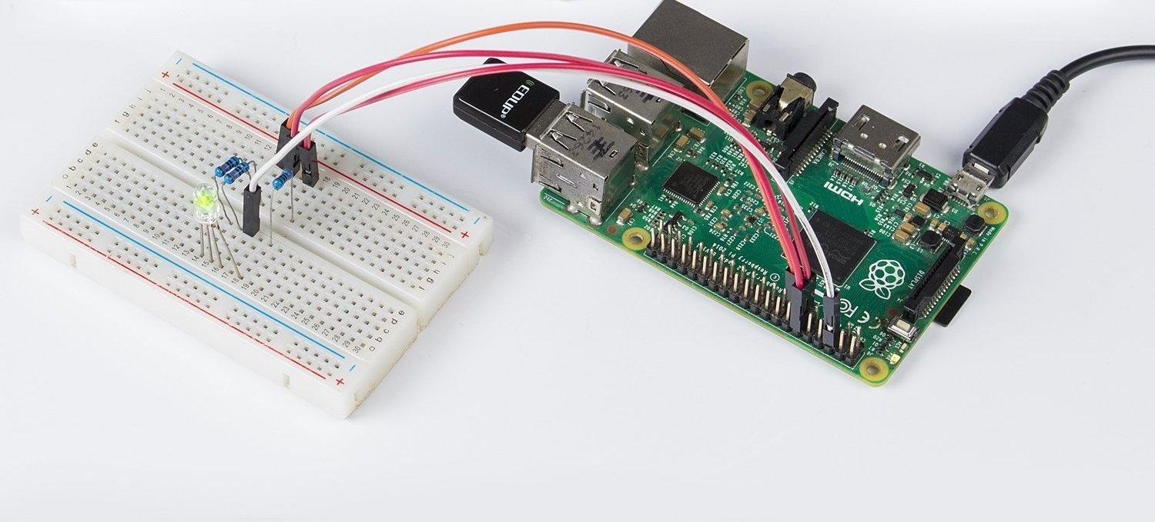
Hardware Requirements
Raspberry Pie 3 B+
End Sensors
Temperature
Pressure
Humidity
Bread Board
Jumper Cables

Slide 19
Database Design
Hadoop End
HDFS (Hadoop Distributed File System)
Hbase
Hive
Sqoop (If needed)
Android End
SQLite

Slide 20
Future Scope
The heavy and deep concepts Implemented in this project can very well be extended to get magnificent working systems in innovative directions-
Unified Project Platform on Cloud
Pattern Prediction through collected data
Increased sets of Sensing data
Varying Analysis algorithms

Slide 21
Conclusion
IoT is the beginning of Industry Evolution 4.0
Big Data the most value creation technology in current scenario
A traditional manufacturing industry insolvency was observed
IoT and Big Data integration proposed in a detailed manner
Much future work an research in direction possible

